Slide 1
K-fold cross Validation

Slide 2
K- fold Cross-validation
Cross-validation is a technique for validating the model efficiency by training it on the subset of input data and testing on previously unseen subset of the input data.
The basic idea behind k-fold cross-validation is to divide the available dataset into k subsets or folds of approximately equal size.
The model is then trained and evaluated k times, each time using a different fold as the validation set and the remaining folds as the training set. This process allows us to obtain k different estimates of the model's performance.

Slide 3
K-Fold Cross-Validation
K-fold cross-validation approach divides the input dataset into K groups of samples of equal sizes. These samples are called folds.
For each learning set, the prediction function uses k-1 folds, and the rest of the folds are used for the test set.
This approach is a very popular CV approach because it is easy to understand, and the output is less biased than other methods.

Slide 4
Steps involved in k-fold cross-validation:
Splitting the data: The original dataset is divided into k subsets of roughly equal size. Each subset is referred to as a fold.
2. Training and validation: For each iteration, one of the folds is used as the validation set, and the remaining k-1 folds are combined to form the training set.
The model is trained on the training set and evaluated on the validation set.

Slide 5
3. Performance evaluation: The performance metric of interest (e.g., accuracy, precision, recall, etc.) is computed for each iteration based on the predictions made on the validation set.
4. Average performance: The performance metrics obtained from the k iterations are averaged to obtain a single performance estimate, which represents the overall performance of the model.
Common choices for the value of k are 5 and 10, but it can vary depending on the size of the dataset and computational resources available.

Slide 6
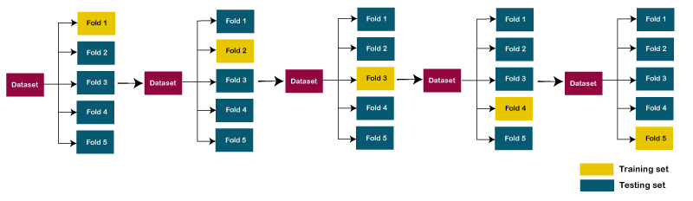
Example of 5-folds cross-validation
Yellow box indicates Test fold and blue box indicates training fold

Slide 7
Overfitting and Underfitting in Machine Learning
Bias: Bias is a prediction error that is introduced in the model due to
oversimplifying the machine learning algorithms.
Or it is the difference between the predicted values and the actual values.
Variance: If the machine learning model performs well with the training dataset, but does not perform well with the test dataset, then variance occurs.

Slide 8
Bias and variance form a trade-off in model performance.
A model with high bias may struggle to learn the true patterns in the data, while a model with high variance may over-interpret the noise in the data.
The goal is to find the right balance between bias and variance, known as the bias-variance trade-off.

Slide 9
In machine learning, underfitting and overfitting are two common issues that can arise when training a model.
They are related to the model's ability to generalize its predictions to unseen data.

Slide 10
Underfitting
Underfitting occurs when a model is too simple or lacks the capacity to capture the underlying patterns in the training data.
This leads to poor performance not only on the training data but also on new, unseen data.
The model fails to learn the complexities and nuances of the data, resulting in high bias.

Slide 11
Underfitting is a situation when your model is too simple for your data.
More formally, your hypothesis about data distribution is wrong and too simple — for example, your data is quadratic and your model is linear.
This situation is also called high bias. This means that your algorithm can do accurate predictions, but the initial assumption about the data is incorrect.

Slide 12
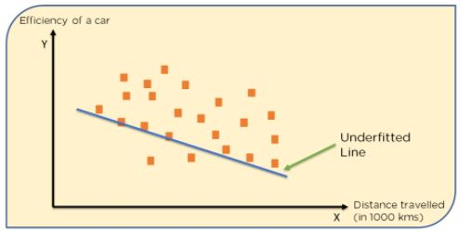
Example of underfitting
Let's consider a scenario where we're trying to fit a linear regression model to predict housing prices based on a single feature, the size of the house in square feet.
However, our model is too simple and suffers from underfitting.

Slide 13
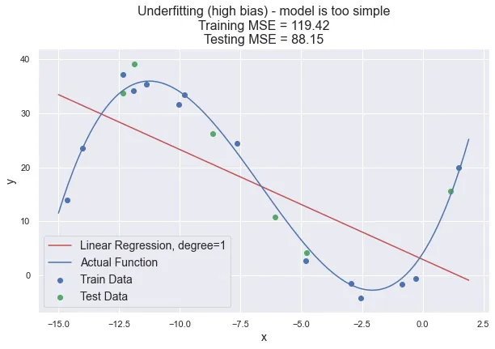
Underfitting. The linear model trained on cubic data.

Slide 14
Reasons for Underfitting
High bias and low variance.
The size of the training dataset used is not enough.
The model is too simple.
Training data is not cleaned and also contains noise in it.

Slide 15
Techniques to Reduce Underfitting
Increase model complexity.
Increase the number of features, performing feature engineering.
Remove noise from the data.
Increase the number of epochs or increase the duration of training to get better results.

Slide 16
Feature engineering
Feature engineering refers to the process of transforming or creating new features from existing raw data to enhance the performance of a machine learning model.
Let's consider an example of predicting housing prices based on a dataset that includes various features such as the number of bedrooms, bathrooms, square footage, and location.

Slide 17
One potential feature engineering technique for this task could involve creating a new feature called "total rooms."
This feature combines the number of bedrooms and bathrooms to provide a single measure of the total number of rooms in a house, which may capture the overall size or capacity of the property.
The intuition behind this feature is that houses with more rooms might generally have higher prices.

Slide 18
In machine learning, an epoch is a complete iteration over the entire training dataset during the training phase of a model.
During each epoch, the model is presented with the entire training dataset, and it performs forward propagation to make predictions on the training examples.
Then, it calculates the loss or error between the predicted outputs and the actual labels.

Slide 19
Afterward, the model adjusts its internal parameters using an optimization algorithm, typically by computing gradients and updating the weights to minimize the loss.
The number of epochs determines how many times the model will go through the entire training dataset.
In practice, the number of epochs is a hyperparameter that needs to be set by the user.

Slide 20
Overfitting
Overfitting happens when a model becomes too complex and starts to memorize the noise or random fluctuations in the training data rather than capturing the true underlying patterns.
The model becomes too specific to the training data and performs poorly on new, unseen data. Overfitting is characterized by low bias but high variance.
Signs of overfitting include a low training error but a significantly higher testing or validation error compared to the training error.

Slide 21
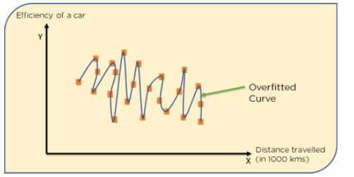
Let's consider a scenario where we're trying to fit a polynomial regression model to predict housing prices based on a single feature, the size of the house in square feet.
However, our model is overly complex and may suffers from overfitting.

Slide 22
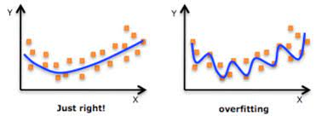

Slide 23
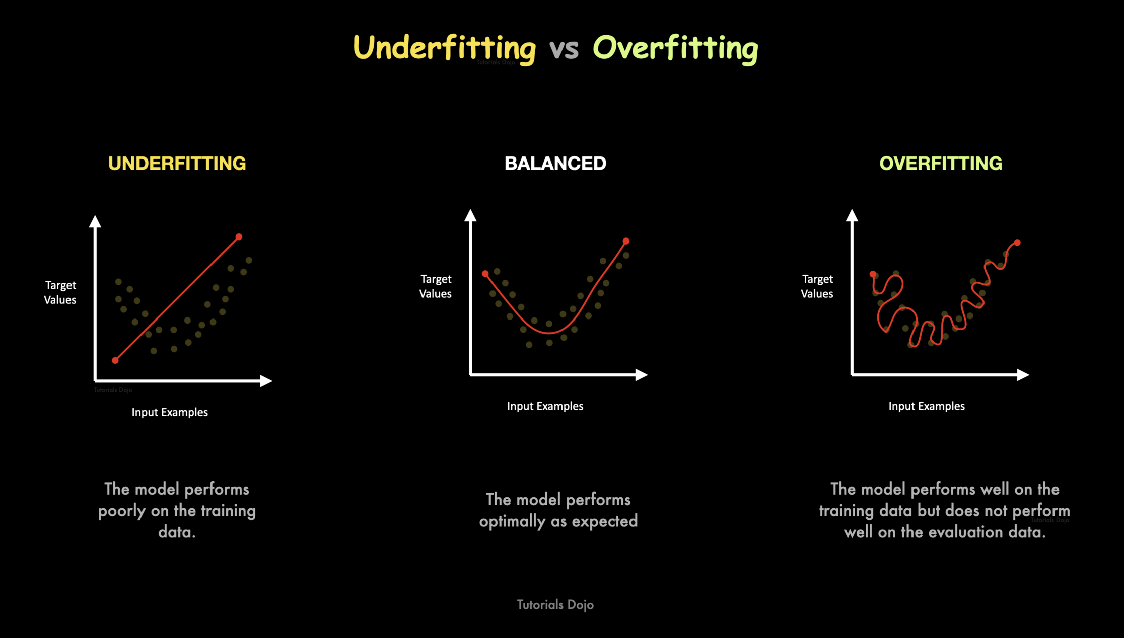

Slide 24
Techniques to Reduce Overfitting
Increase training data.
Reduce model complexity.
Using K-fold cross-validation
Using Regularization techniques such as Lasso and Ridge
Use dropout for neural networks to tackle overfitting.

Slide 25
Regularization techniques
Regularization is a technique used in machine learning to prevent overfitting.
Regularization helps in reducing the model's reliance on specific patterns in the training data and encourages it to learn more generalized patterns that can be applied to unseen data.
The goal of regularization is to add a penalty term to the model's objective function, which discourages the model from assigning excessive importance to certain features or from fitting the training data too closely.
By doing so, regularization promotes simplicity and reduces the model's complexity.

Slide 26
The most common types of regularization techniques used in machine learning are L1 regularization (Lasso) and L2 regularization (Ridge).
Both techniques add a regularization term to the loss function that the model minimizes during training.

Slide 27
L1 regularization (Lasso)
L1 regularization, also known as Lasso regularization, is a technique used in machine learning to apply a penalty to the absolute values of the coefficients in a model.
It encourages sparsity by driving some coefficients to zero, effectively selecting a subset of the most important features.
The main advantage of L1 regularization is that it performs feature selection automatically.
By driving some coefficients to zero, L1 regularization effectively eliminates less relevant or redundant features, resulting in a sparse model with only the most important features remaining.

Slide 28
Mathematically, the loss function with L1 regularization can be represented as follows:
Loss = Original Loss Term + alpha* sum(|coefficients|)
Loss is proportional to the sum of the absolute values of the coefficients multiplied by the regularization parameter (lambda or alpha).
The L1 penalty term encourages sparsity by driving some coefficients to zero.

Slide 29
Ridge regularization
In Ridge regularization, a penalty term is added to the loss function, which encourages the model to keep the coefficients of the features small. This penalty term is proportional to the sum of the squares of the coefficients.
Mathematically, the loss function for Ridge regression can be represented as:
Loss = Sum of squared differences between predicted and actual prices + alpha * (sum of squares of coefficients)

Slide 30
Here, Alpha is the regularization parameter that controls the strength of regularization. A larger value of α will result in stronger regularization, while a smaller value will allow the model to fit the training data more closely.
By adding the regularization term, the model is penalized for having large coefficients, which helps in reducing the impact of irrelevant or highly correlated features. As a result, the model becomes more robust and less prone to overfitting.

Slide 31
Regularization can be applied to various types of machine learning models, including linear regression, logistic regression, support vector machines, and neural networks.
It helps in improving the model's generalization performance by reducing overfitting, making the model more robust and reliable when faced with new, unseen data.

Slide 32
General Intuition to Remember
underfitting occurs when your model is too simple for your data.
overfitting occurs when your model is too complex for your data.
Based on this, simple intuition you should keep in mind is:
to fix underfitting, you should complicate the model.
to fix overfitting, you should simplify the model.

Slide 33
https://towardsdatascience.com/overfitting-and-underfitting-principles-ea8964d9c45c

Slide 34
What is GridSearch?
GridSearch is a technique used in machine learning to find the optimal hyperparameters for a given model.
Hyperparameters are settings that are not learned from the data but are set before the training process.
Examples of hyperparameters include the learning rate in a neural network, the regularization parameter in a linear regression model, or the maximum depth of a decision tree.
We define the grid of parameters that we want to search through, and we select the best combination of parameters for our data.

Slide 35
GridSearch automates the process of systematically exploring different combinations of hyperparameter values and selecting the best combination that yields the optimal performance of the model.

Slide 36
The “Search” in GridSearch
The hypothesis is that there is a specific combination of values of the different hyperparameters that will minimize the error of our predictive model.
Our goal using GridSearch is to find this specific combination of parameters.

Slide 37
The “Grid” in GridSearch
GridSearch’s idea for finding this best parameter combination is is simple: just test each parameter combination possible and select the best one!
Not really each combination possible though, since for a continuous scale there would be infinitely many combinations to test.
The solution for this is to define a Grid. This Grid defines for each hyperparameter, which values should be tested.

Slide 38
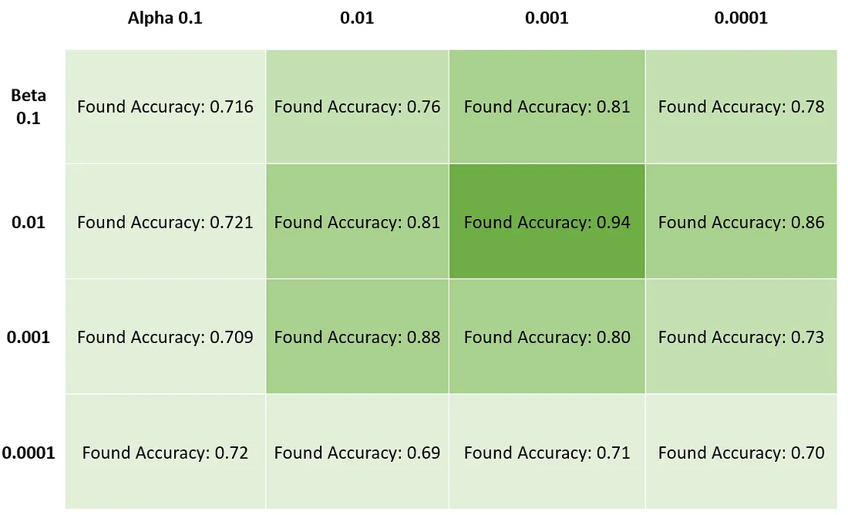
In an example case where two hyperparameters — Alpha and Beta— are tuned: we could give both of them the values [0.1, 0.01, 0.001, 0.0001] resulting in the following “Grid” of values. At each crossing point, our GridSearch will fit the model to see what the error at this point is.

Slide 39
The “Cross-Validation” in GridSearch
When testing the performance of a model with each combination of hyperparameters, there could be a risk of overfitting.
This means that just by pure chance, only the training data set corresponded well to this particular hyperparameter combination! The performance on new, real-life data, could be much worse!

Slide 40
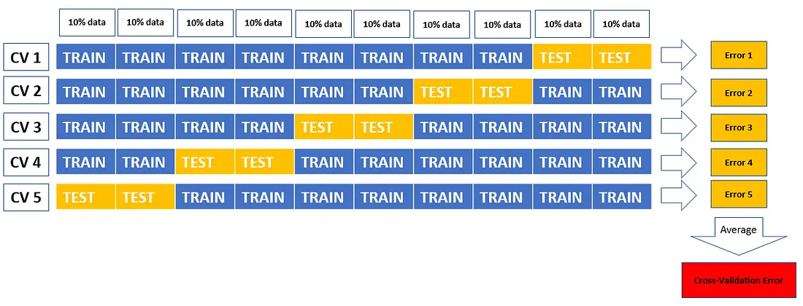
To get a more reliable estimate of the performances of a hyperparameter combination, we take the Cross Validation Error.

Slide 41
What makes GridSearch so important?
GridSearch allows us to find the best model given a data set very easily. It actually makes the Machine Learning part of the Data Scientists role much easier by automating the search.

Slide 42
Iris Datasets
There are four features:
(1)sepal length in cm
(2) sepal width in cm
(3) petal length in cm
(4) petal width in cm
Output class: -- Iris Setosa -- Iris Versicolour -- Iris Virginica

